Slide 1
DATA STRUCTURES AND ALGORITHMS

Slide 2
POINTERS

Slide 3
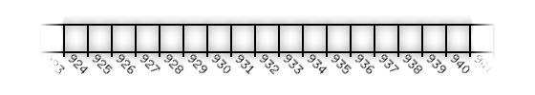
POINTERS
Essentially, the computer's memory is made up of bytes. Each byte has a number, an address, associated with it.
The picture below represents several bytes of a computer's memory. In the picture, addresses 924 thru 940 are shown.

Slide 4
POINTERS
C++ Code Listing 1
1: #include <iostream>
2: int main()
3: {
4: float fl=3.14;
5: std::cout << fl << std::endl;
6: return 0;
7: }

Slide 5
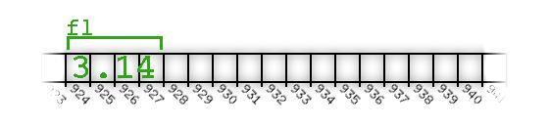
POINTERS
When fl is used in line (5), two distinct steps occur:
The program finds and grabs the address reserved for fl--in this example 924.
The contents stored at that address are retrieved
To generalize, whenever any variable is accessed, the above two distinct steps occur to retrieve the contents of the variable.

Slide 6
Separating the Steps
C++ Code Listing 2
1: #include <iostream>
2: int main()
3: {
4: float fl=3.14;
5: std::cout << "fl's address=" << (unsigned int) &fl << std::endl;
6: return 0;
7: }
On line (5) of the example, The & operator is being used on fl. On line (5), only step 1 is being performed on a variable i.e. The program finds and grabs the address reserved for fl...
It is fl's address that is printed to the screen. If the & (reference operator, and which can be literally translated as "address of“) operator had not been placed in front of fl, then step 2 would have occurred as well, and 3.14 would have been printed to the screen.

Slide 7
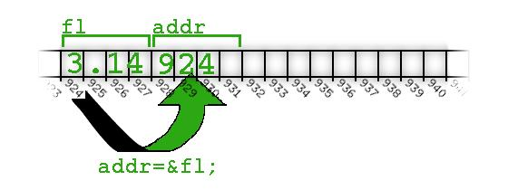
POINTERS
C++ Code Listing 3
1: #include <iostream>
2: int main()
3: {
4: float fl=3.14;
5: unsigned int addr=(unsigned int) &fl;
6: std::cout << "fl's address=" << addr << std::endl;
7: return 0;
8: }

Slide 8
POINTERS
Now let's test the other operator, the * (dereference operator and that can be literally translated to "value pointed by“) that retrieves the contents stored at an address:
C++ Code Listing 4
1: #include <iostream>
2: int main()
3: {
4: float fl=3.14;
5: unsigned int addr=(unsigned int) &fl;
6: std::cout << "fl's address=" << addr << std::endl;
7: std::cout << "addr's contents=" << * (float*) addr << std::endl;
8: return 0;
9: }
In line (7), step 2 has been performed on a number i.e. The contents stored at that address [addr] are retrieved.

Slide 9
OK, But why do we need & and *?
C++ Code Listing 5
1: #include <iostream>
2: void somefunc(float fvar)
3: {
4: fvar=99.9;
5: }
6: int main()
7: {
8: float fl=3.14;
9: somefunc(fl);
10: std::cout << fl << std::endl;
11: return 0;
12: }

Slide 10
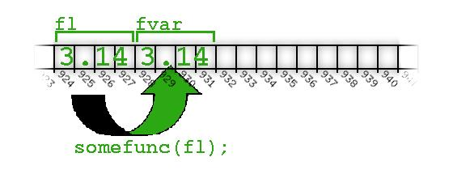
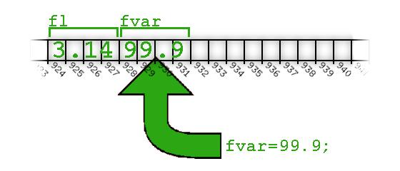
POINTERS
Execution jumps to line (2) to run the function
fvar is created as its own variable and fl's value is copied into fvar
On line (4), 99.9 is assigned to fvar
Now that the function is finished, execution resumes in main where it left off (line 10). The fl variable is unchanged, 3.14 prints out.

Slide 11
POINTERS
1: #include <iostream>
2: void somefunc(unsigned int fptr)
3: {
4: *(float*)fptr=99.9;
5: }
6:
7: int main()
8: {
9: float fl=3.14;
10: unsigned int addr=(unsigned int) &fl;
11: somefunc(addr);
12: std::cout << fl << std::endl;
13: return 0;
14: }

Slide 12
POINTERS
The floating point variable fl is created at line (9) and given the value 3.14
The & operator is used on fl at line (10) (do only step 1, get the address). The address is stored in the integer variable addr.

Slide 13
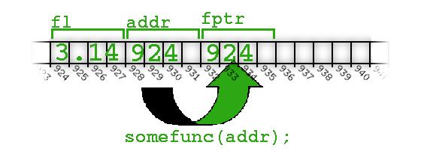
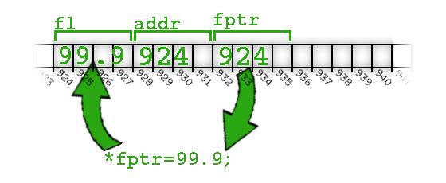
The function somefunc is called at line (11) and fl's address is passed as an argument.
The function somefunc begins at line (2), fptr is created and fl's address is copied into fptr.
The * operator is used on fptr at line (4) -- do step 2, the contents stored in an address are retrieved. In this example, the contents at address 924 are retrieved.
The contents at address 924 are assigned the value 99.9.

Slide 14
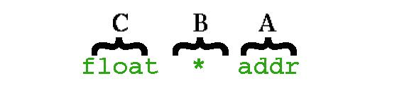
POINTERS
1:...
2: float fl=3.14;
3: float * addr = &fl;
4:...
Even with the * instead of Ptr, addr is described the same way:
(A) addr is an integer. (B) However, it is a special integer designed to hold the address of a (C) float

Slide 15
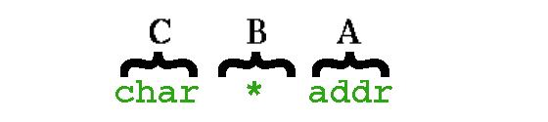
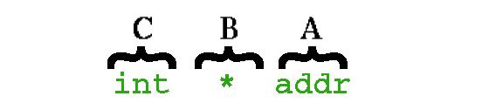
These variables are described this way, regardless of the type:
(A) addr is an integer. (B) However, it is a special integer designed to hold the address of a (C) char
(A) addr is an integer. (B) However, it is a special integer designed to hold the address of an (C) int

Slide 16
POINTERS
This "...special integer..." way of describing these variables is a mouthful, so we shorten it and just say "addr is a float pointer" or "addr is a pointer to a float" (or char, or int, etc).
Unfortunately, the language creators chose the * character to replace Ptr. The * character is confusing because the * character is also used to get the contents at an address ("do step 2 on a number").
NOTE: These two uses of the * character have nothing to do with each other.

Slide 17
What is all that "syntax sugar" anyway? (Casting)
Let's take one last look at our original code that illustrates the utility of separating out steps 1 & 2.
1: #include <iostream>
2: void somefunc(unsigned int fptr)
3: {
4: *(float*)fptr=99.9;
5: }
6:
7: int main()
8: {
9: float fl=3.14;
10: unsigned int addr=(unsigned int) &fl;
11: somefunc(addr);
12: std::cout << fl << std::endl;
13: return 0;
14: }

Slide 18
POINTERS
In nearly all of the code samples, you have been asked to ignore certain bits of the code. These bits of code have always appeared around those areas where we are either taking the address of a variable or getting the contents at an address (doing step 1 or step 2 on a variable)
Those bits of "syntax sugar" are there to keep the compiler from complaining. The first example of this in the above program is on line (10).
On line (10) we are taking the address of the floating point number fl ("do only step 1 on a number"). After we get that address, we store it in addr.

Slide 19
Why would the compiler complain?
Because when we assign the address of fl to addr, the compiler does not expect addr to be an unsigned int. The compiler expects addr to be a float *. That is, a special integer designed to hold the address of a float. To keep the compiler from complaining, we tell the compiler to treat &fl as an unsigned int rather than a float *.
This "syntax sugar" that causes the compiler to treat variables and expressions differently is called casting. The way a programmer describes line (10) is: "The address of fl is being cast into an unsigned int and assigned to addr"
The other place casting occurs is on line (4). On line (4), we are getting the contents at an address ("do step 2 on a number/address"). The address of our float is in stored in fptr, which is an unsigned int, not a float *. We tell the compiler to treat fptr as the address of a floating point number by casting it into a float *. Once we tell the compiler this, we can get the contents at the address without complaint.

Slide 20
Putting it all together
The only reason our examples up till now have required casting is because we were storing our addresses in unsigned int variables. The language designers want us to store addresses in the "special integer" variables, that is, the pointer variables they designed for just such a purpose.
Once we replace our unsigned int variables with these pointer variables, none of the casting is required.

Slide 21
POINTERS
1: #include <iostream>
2: void somefunc(float* fptr)
3: {
4: *fptr=99.9;
5: }
6:
7: int main()
8: {
9: float fl=3.14;
10: float* addr = &fl;
11: somefunc(addr);
12: std::cout << fl << std::endl;
13: return 0;
14: }

Slide 22
POINTERS
On line (10), when we take the address of fl and the address is assigned to a variable designed to hold it. No casting is required.
When addr is passed to the function in line (11), addr is copied to fptr on line (2).
Line (2) shows that fptr is created as a float pointer, that is a variable designed to hold the address of a floating point number. As a result, no casting is needed on line (4) where the contents at the address are retrieved.

Slide 23
ARRAYS

Slide 24
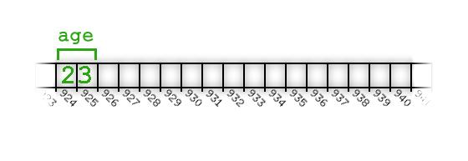
Array basics
Let's start by looking at a single variable used to store a person's age.
1: #include <iostream>
2:
3: int main()
4: {
5: short age;
6: age=23;
7: std::cout << age << std::endl;
8: return 0;
9: }
Not much to it. The variable age is created at line (5) as a short. A value is assigned to age. Finally, age is printed to the screen.

Slide 25
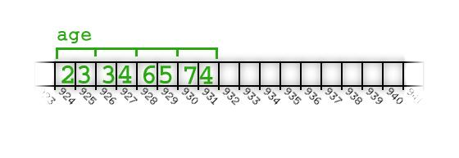
Array basics
Here's how to create an array and one way to initialize it:
1: #include <iostream>
2:
3: int main()
4: {
5: short age[4];
6: age[0]=23;
7: age[1]=34;
8: age[2]=65;
9: age[3]=74;
10: return 0;
11: }
On line (5), an array of 4 short's is created. Values are assigned to each variable in the array on line (6) through line (9).

Slide 26
Printing Arrays
Our program is a bit unrevealing in that we never print the array to screen. Here is the same program with an attempt to print the array to the screen:
1: #include <iostream>
2:
3: int main()
4: {
5: short age[4];
6: age[0]=23;
7: age[1]=34;
8: age[2]=65;
9: age[3]=74;
10:
11: std::cout << age << std::endl;
12: return 0;
13: }
Line (11) is meant to print the 4 ages to the screen. But instead of printing out the four short variables, what appears to be nonsense prints out instead.

Slide 27
How about printing out each of the values separately?
1: #include <iostream>
2:
3: int main()
4: {
5: short age[4];
6: age[0]=23;
7: age[1]=34;
8: age[2]=65;
9: age[3]=74;
10: std::cout << age[0] << std::endl;
11: std::cout << age[1] << std::endl;
12: std::cout << age[2] << std::endl;
13: std::cout << age[3] << std::endl;
14: return 0;
15: }
Lines (10) through line (13) produce the output we are expecting.

Slide 28
Copying arrays
Suppose that after filling our 4 element array with values, we need to copy that array to another array of 4 short's?
1: #include <iostream>
2:
3: int main()
4: {
5: short age[4];
6: short same_age[4];
7: age[0]=23;
8: age[1]=34;
9: age[2]=65;
10: age[3]=74;
11:
12: same_age=age;
13:
14: std::cout << same_age[0] << std::endl;
15: std::cout << same_age[1] << std::endl;
16: std::cout << same_age[2] << std::endl;
17: std::cout << same_age[3] << std::endl;
18: return 0;
19: }

Slide 29
1: #include <iostream>
2:
3: int main()
4: {
5: short age[4];
6: short same_age[4];
7:
8: age[0]=23;
9: age[1]=34;
10: age[2]=65;
11: age[3]=74;
12:
13: same_age[0]=age[0];
14: same_age[1]=age[1];
15: same_age[2]=age[2];
16: same_age[3]=age[3];
17:
18: std::cout << same_age[0] << std::endl;
19: std::cout << same_age[1] << std::endl;
20: std::cout << same_age[2] << std::endl;
21: std::cout << same_age[3] << std::endl;
22: return 0;
23: }

Slide 30
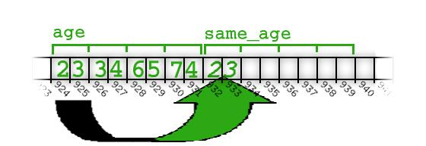
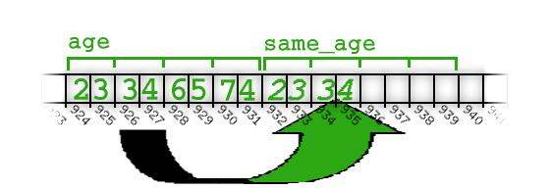
Copying arrays
In order to copy the four elements in age into the same_age array, we must do it element by element.
Copy first element
Copy second element
…….and so on.

Slide 31
ADVANTAGE?
The technique used to copy one array into another is exactly the same as the technique used to copy 4 separate variables into 4 other variables. So what is the advantage to using arrays over separate variables?
One significant advantage of an array over separate variables is the name. In our examples, using four separate variables requires 4 unique names. The 4 short variables in our array have the same name, age. The 4 short's in the array are identical except for an index number used to access them. This distinction allows us to shorten our code in a way that would be impossible with 4 variables, each with unique names:

Slide 32
Copying arrays
1: #include <iostream>
2:
3: int main()
4: {
5: short age[4];
6: short same_age[4];
7: int i, j;
8: age[0]=23;
9: age[1]=34;
10: age[2]=65;
11: age[3]=74;
12:
13: for(i=0; i<4; i++)
14: same_age[i]=age[i];
15:
16: for(j=0; j<4; j++)
17: std::cout << same_age[j] << std::endl;
18: return 0;
19: }

Slide 33
Array Internals
To understand what exactly is happening inside of arrays, first recall the behavior of variables from the pointer section:
1: #include <iostream>
2: int main()
3: {
4: float fl=3.14;
5: std::cout << fl << std::endl;
6: return 0;
7: }
At line (4) in the program above, the computer reserves memory for fl. In our examples, we'll assume that a float requires 4 bytes.

Slide 34
Array Internals
When fl is used in line (5), two distinct steps occur:
  The program finds and grabs the address reserved for fl--in this example 924.
  The contents stored at that address are retrieved
To generalize, whenever any variable is accessed, the above
two distinct steps occur to retrieve the contents of the
variable.
So, how is this related to referring to arrays without providing
an index number (e.g. age, not age[2])?

Slide 35
Array Internals
1: #include <iostream>
2:
3: int main()
4: {
5: short age[4];
6: age[0]=23;
7: age[1]=34;
8: age[2]=65;
9: age[3]=74;
10:
11: std::cout << age << std::endl;
12: return 0;
13: }
Line (11) prints out nonsense, not the contents of our array.
Let's apply the 2 steps from the pointers tutorial to our array on line (11):

Slide 36
  On line (11), the program finds and grabs the address reserved for age. Simple enough. According to the image, age starts at address 924 so it is address 924 that is grabbed.
  The contents stored at that address are retrieved (Oops!).
Step 2 is the problem. Our array has four values, not just one. To retrieve
the contents at 924 would be inappropriate because 924 is the address of
the first value in the array, not all values in the array.
As a result, step 2 isn't performed on arrays, just step 1. The output from
line (11) is the address of the array: step 2 has not occurred. In order to
get a value from an array, the programmer must "manually" do step 2 to
retrieve the contents.

Slide 37
Accessing elements in an array
From the pointer section, we know that in order to get the contents at an
address we use the * operator. Let's try it on our printing example:
1: #include <iostream>
2:
3: int main()
4: {
5: short age[4];
6: age[0]=23;
7: age[1]=34;
8: age[2]=65;
9: age[3]=74;
10:
11: std::cout << *age << std::endl;
12: return 0;
13: }

Slide 38
Accessing elements in an array
On line (11) the * operator has been added. When this code is compiled and executed, 23 prints to the screen. When just the array's name is provided, only step 1 occurs with an array. We then manually do step 2 to get the contents at that address--namely the value of the first element of our array.
We know that when we use the name of an array, step 1 occurs and we get the address of the first element of that array. We also know (from the pointers section) that an address is nothing more than an integer. Given that the address is nothing but an integer, we can use addition to access the other array elements!
The big question is: How much do we add to age in line (11) above to get the address of the second element in the age array?

Slide 39
Accessing elements in an array
In C++ you add "1" to age (that is, the address of age) to access the second element, add "2" to age to access the third element, & so on.
Here is how we can print the value of the second element in the array:
1: #include <iostream>
2:
3: int main()
4: {
5: short age[4];
6: age[0]=23;
7: age[1]=34;
8: age[2]=65;
9: age[3]=74;
10:
11: std::cout << *(age+1) << std::endl;
12: return 0;
13: }

Slide 40
Accessing elements in an array
Line (11) now shows pointer arithmetic in action:
  Step 1 is done on age--the address 924 is returned.
  Using pointer arithmetic, 1 is added to 924 which produces the address of the next element in the array. Looking at the image of our example, the result is 926.
  Using the * operator ("do step 2 on a number"), the contents at that address are retrieved. The content at address 926 is the number 34, which is what prints to the screen.
  The parentheses are required to ensure that the * operator and the +
  operator occur in the correct order. This is due to operator
  precedence rules.

Slide 41
Pointer Arithmetic
If you recall from the pointers section, pointers in C++ are typed. That is,
in C++ you can have float pointers, int pointers, char pointers, etc.
Here's an excerpt from a side note in the pointers section:
...A primary motivation for having a pointer type for each variable type is to help the compiler. Referring back to an earlier example, when we get the contents at an address ("do step 2 on a number"), the compiler must know how to get the contents at the address.
The compiler needs to know two things when getting the contents at an address:
  How many bytes starting at the given address make up the value. For example, does the address refer to a 2 byte short int or a 4 byte float or an 8 byte double?
  How to convert those bytes into the value. That is, the process for converting 4 bytes into a float is different than the process for converting 2 bytes into a short int.

Slide 42
Pointer Arithmetic
We've seen that when the name of an array is specified all by
itself, only step 1 is done, not step 2. After step 1, we have
the address to the first element in the array. In other words,
it is a pointer! What kind of pointer? The type of the pointer
is the same type as the array. In our sample program we
created an array of short integers. So, the address is a short
pointer (that is, it is a: short*).
The type of the pointer not only allows the compiler to
correctly get the contents at an address, but it also allows the
compiler to correctly calculate the number of bytes to add
when doing pointer arithmetic.

Slide 43
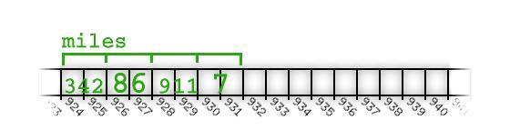
Pointer Arithmetic
1: int miles[4];
2: miles[0]=342;
3: miles[1]=86;
4: miles[2]=911;
5: miles[3]=7;
6: ... *(miles+2) ...
In line (6), miles is the address of an integer, or an int*. By the rules of
pointer arithmetic, line (6) will get the contents at address 928.

Slide 44
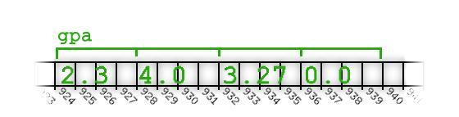
Pointer Arithmetic
1: float gpa[4];
2: gpa[0]=2.3;
3: gpa[1]=4.0;
4: gpa[2]=3.27;
5: gpa[3]=0.0;
6: ... *(gpa+2) ...
In line (6), gpa is the address of a floating point number, or a
float*. By the rules of pointer arithmetic, line (6) will get the
contents at address 932.

Slide 45
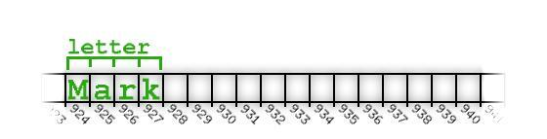
Pointer Arithmetic
In line (4), gpa is the address of a floating point number, or a float*. By
the rules of pointer arithmetic, line (4) will get the contents at address
932.
1: char letter[4];
2: letter[0]='M';
3: letter[1]='a';
4: letter[2]='r';
5: letter[3]='k';
6: ... *(letter+2) ...
In line (6), letter is the address of an character, or a char*. By the rules
of pointer arithmetic, line (6) will get the contents at address 926.

Slide 46
Array Basics Revisited
Prior to diving into this whole step 1 step 2 business with arrays we were
initializing, printing, copying, and in general accessing array elements
using square braces:
1: #include <iostream>
2:
3: int main()
4: {
5: short age[4];
6: age[0]=23;
7: age[1]=34;
8: age[2]=65;
9: age[3]=74;
10:
11: std::cout << age[2] << std::endl;
12: return 0;
13: }

Slide 47
Array Basics Revisited
On lines (6-9) we are using square braces to access elements for
initialization. On line (11) we are using square braces to print out the third
element of the array. From the previous section you might have been led
to believe that you would print out the third element by putting
something like *(age+2). As it turns out, the *(age+2) syntax is the
"correct" syntax, in terms of how the language handles arrays (and
pointers).
The square braces syntax is nothing more than a shorthand for the
pointer syntax. When you type age[2], the compiler internally converts it
to: *(age+2). In fact, whenever you use the square braces, the compiler
just blindly substitutes the first term into the left-hand side of the addition
and the second term into the right-hand side of the addition:

Slide 48
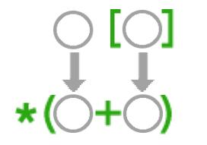
Array Basics Revisited
This is actually what happens. If you type monkey[ crackers ], the compiler tries to compile *(monkey + crackers)
Let's prove it!

Slide 49
Array Basics Revisited
When as a youngster you were asked to add 5+3, no problem. But what about when the numbers were switched and you were asked to add 3+5? Still no problem because of the commutative property of addition. The commutative property of addition holds in C++ just like it did when you were a youngster. So, *(age+2) produces exactly the same result as *(2+age). That is, the number of bytes equivalent to two short integers is added to age and then the contents are retrieved at that address.
OK, so what?
In the previous paragraph I said that when you write something like age[2] the compiler blindly substitutes it into its pointer syntax and compiles *(age+2). So, let's turn it around and prove that all of this array stuff is nothing but simple pointer access with a little addition.

Slide 50
Array Basics Revisited
1: #include <iostream>
2:
3: int main()
4: {
5: short age[4];
6: 0[age]=23;
7: 1[age]=34;
8: 2[age]=65;
9: 3[age]=74;
10:
11: std::cout << 2[age] << std::endl;
12: return 0;
13: }

Slide 51
Array Basics Revisited
The commutative property of addition is being taken advantage of in lines (6-9) and line (11).
Again, this is nothing but simple pointer arithmetic. For example, on line (11), the third element of the age array is accessed. Before compiling 2[age], the compiler first blindly converts it into *(2+age).
Pretty cool, isn’t it?
We now have more than enough information to answer the question:
"Why do arrays in C++ start at zero instead of one?"
We know that the name of the array produces the address of the beginning of the array; and we know that the beginning of the array is also the address of the first element of the array. So, all of these are exactly the same:
*age
*(age+0)
age[0]

Slide 52
SUMMARY
To access any element in an array provide:
  The name of the array. This gets the address of the first element of the array.
  A number. Pointer arithmetic is used to add this number to the address resulting in the address of one of the elements in the array. Of course if zero is added the address is unchanged (it remains the address of the first element).
  Use the * operator to get the contents at that address. Alternately use the square bracket syntax and the compiler will do the addition and content retrieval for you.

Slide 53
RECORDS / C++ STRUCTS

Slide 54
RECORDS
Recall that elements of arrays must all be of the same type. In some situations however, we may wish to group elements of different types. Records are used to group related components of different types. Components of the record are called fields.
In C++
  record called a struct (structure)
  fields called members
C++ Struct
  structured data type
  fixed number of components
  elements accessed by name, not by index
  components may be of different types

Slide 55
Declaring struct Variables
Given:
struct part_struct {
char descrip [31], part_num [11];
float unit_price;
int qty; };
Declare : (Use struct name as a type)
part_struct new_part, old_part;

Slide 56
Accessing Components
Use the name of the record & the name of the member, separated by a dot.
old_part.qty = 5;
cout << new_part.descrip;
The dot is called the member selector.

Slide 57
Aggregate Operations with Structures
Recall that arrays had none (except reference parameter). Structures DO have aggregate operators. They are:
assignment statement =
parameter (value or reference)
return a structure as a function type
Limitations on aggregate operations
No I/O
cout << old_part;
cin >> new_part;
No arithmetic operations
old_part = new_part + old_part;
No comparisons
if (old_part < new_part)
cout << ...;
Struct variables must be compared member-wise e.g. to compare the values of student and newStudent, you must compare them member-wise, as follows:
if(student.firstName == newStudent.firstName &&
student.lastName == newStudent.lastName) ...

Slide 58
RECORDS
Input/Output
There are no aggregate input/output operations on struct.
Data in a struct variable must be read one member at a time.
Contents of a struct must be written one member at a time.
Struct Variables and Functions
A struct variable can be passed as a parameter either by
value or by reference.
A function can return a value of the type struct

Slide 59
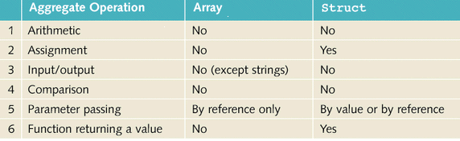
Contrast Arrays and structs
Based on Aggregate Operation

Slide 60
Arrays of Records
First declare a struct (such as part_struct)
Then specify an array of that type
Access elements of the array, elements of the struct
part_struct part_list [50];
for (x = 0; x <50; x++)
cout << _______________________;
part_list[x].descrip

Slide 61
Records with Arrays
Example
const arraySize = 1000;
struct listType
{
int elements[arraySize];
//array containing the list
int listLength;
//length of the list
}

Slide 62
Hierarchical Records
Definition => records where at least one of the components is, itself, a record.
Example:
struct inventory_struct {
part_struct part;
int qty_sold, re_order_qty;
vendor_struct vendor; };

Slide 63
Unions
Definition => a struct that holds only one of its members at a time during program execution.
union Qty_type {
int count;
float linear_ft;
long cu_in; };
Qty_type how_many;
At run time, how_many
contains either
an int
a float
a long . . .
But … never all three

Slide 64
Choosing Data Structures
Strive to group logical elements of a structure together
  calls for hierarchical structures
Push details of entities down to lower levels of the structure
Data Abstraction <=> separation of logical properties of a data type from its implementation

Slide 65
Testing and Debugging Hints
Declaration of a struct type must end with a semicolon ;
Be sure to specify the full member selector when referencing a component of a struct variable
  don’t leave out the struct name
When using an array in a struct, the index goes at the end
student_rec.scores[x]
When using an array of struct, the index goes after the struct name
parts_list[x].qty

Slide 66
Testing and Debugging
Process struct members separately … the only aggregate operations will be
  Assignment =
  Parameter passing
  void do_it (part_struct part);
  Function return
  part_struct blanked_part ( );
Be careful using same member names in different struct types
Compiler keeps them separate OK
Human readers can easily confuse them
struct parts {
int qty;
. . .
} ;
struct test_scores {
int qty;
. . .
} ;

Slide 67
ABSTRACT DATA
TYPES

Slide 68
The Stack ADT
A stack is a list with the restriction that insertions and deletions are performed at one end of the list only (called the top of the stack). A stack obeys the LIFO order. A LIFO structure is a last-in-first-out data structure, i.e. the last item to that is stored is the first to be retrieved from it.

Slide 69
Stack operations
Since a stack is just a special type of list, the operations associated with the LIST ADT can be used to implement a stack. When these operations are assigned to a stack, we assign special names to them. The operations are:
  Push (S, x): insert x at the top of the stack
  Pop (S): delete the data element that is at the top of the stack
  Top (S): return the data element that is at the top of the stack
In practice, the Pop operation is implemented so that it returns the item at the top of the stack before deleting it. Performing Pop or Top operations on an empty stack returns an error.

Slide 70
Implementing Stack ADT
The Stack ADT can be implemented using either an array-base or linked list. In both cases, we have two choices: we can keep the top-of-stack at the head or the tail of the list.
The disadvantage of using an array is that we need to specify an array size at compile time.
  if the size is set too large, we waste space;
  if the size is set too small, stack could get overflowed.
If we do not have an idea of how big the stack can get, we use a linked list; otherwise an array implementation is simple and more efficient.

Slide 71
Array-based implementation
It is most efficient to keep the top-of-stack at the tail of the list. In this
case, we simply append a new element at the tail of the list on a Push
operation and delete an element from the tail of the list in a Pop
operation. Both these operations can be implemented in Θ(1) time.
The stack of elements of type T can be declared as
class Stack {
private:
int tos;
T arrStack[MAXLEN];
public:
//declarations of methods
…
}
The Stack can be initialized using the default constructor
Stack () {
tos ← -1; //Empty stack. First element is index 0
}

Slide 72
Array-based implementation
The Push (x) and Pop operations are:
Push (x)
If tos = MAXLEN –1
return (“Stack overflow”)
tos ← tos + 1
arrStack[tos] ← x
Pop ()
If tos = –1
return (“Stack Underflow”)
x = arrStack[tos]
tos ← tos - 1
return x

Slide 73
Linked List implementation
In a linked list implementation, elements can be stored at either the head or tail of the list (assuming we store a pointer to the tail) and both Push and Pop can be implemented in Θ(1) time.
tos
cat
rat
bat
dog
*

Slide 74
Linked List implementation
The Push (x) and Pop () operations for the linked list
implementations is given below:
Push (x)
newNode ← new Node(x)
newNode->next = tos
tos = newNode
Pop ()
if tos = NULL
return (“stack Underflow”)
oldNode ← tos
tos ← tos->next

Slide 75
CONSTRUCT STACK
#include <iostream>
#include <vector>
#include <deque> //DOUBLE ENDED QUEUE
#include <stack>
using namespace std;
int main ()
{
deque<int> mydeque (3,100); // deque with 3 elements
vector<int> myvector (2,200); // vector with 2 elements
stack<int> first; // empty stack
stack<int> second (mydeque); // stack initialized to copy of deque
stack<int,vector<int> > third; // empty stack using vector
stack<int,vector<int> > fourth (myvector);
cout << "size of first: " << (int) first.size() << endl;
cout << "size of second: " << (int) second.size() << endl;
cout << "size of third: " << (int) third.size() << endl;
cout << "size of fourth: " << (int) fourth.size() << endl;
return 0;
}

Slide 76
CONSTRUCT STACK
Output:
size of first: 0
size of second: 3
size of third: 0
size of fourth: 2

Slide 77
STACK IS EMPTY
#include <iostream>
#include <stack>
using namespace std;
int main ()
{
stack<int> mystack;
int sum (0);
for (int i=1;i<=10;i++) mystack.push(i);
while (!mystack.empty())
{
sum += mystack.top();
mystack.pop();
}
cout << "total: " << sum << endl;
return 0;
}

Slide 78
STACK IS EMPTY
The example initializes the content of the
stack to a sequence of numbers (form 1 to
10). It then pops the elements one by one
until it is empty and calculates their sum.
Output:
total: 55

Slide 79
STACK SIZE
#include <iostream>
#include <stack>
using namespace std;
int main ()
{
stack<int> myints;
cout << "0. size: " << (int) myints.size() << endl;
for (int i=0; i<5; i++) myints.push(i);
cout << "1. size: " << (int) myints.size() << endl;
myints.pop();
cout << "2. size: " << (int) myints.size() << endl;
return 0;
}
Output:
0. size: 0
1. size: 5
2. size: 4

Slide 80
STACK TOP
// stack::top
#include <iostream>
#include <stack>
using namespace std;
int main ()
{
stack<int> mystack;
mystack.push(10);
mystack.push(20);
mystack.top() -= 5;
cout << "mystack.top() is now " << mystack.top() << endl;
return 0;
}
Output:
mystack.top() is now 15

Slide 81
PUSH ON/POP STACK
// stack::push/pop
#include <iostream>
#include <stack>
using namespace std;
int main ()
{
stack<int> mystack;
for (int i=0; i<5; ++i) mystack.push(i);
cout << "Popping out elements...";
while (!mystack.empty())
{
cout << " " << mystack.top();
mystack.pop();
}
cout << endl;
return 0;
}
Output: Popping out elements... 4 3 2 1 0

Slide 82
The List ADT
A list is an ordered set of elements i.e.
L = (l1, l2, …, ln)
where li is the i-th element of the list
The elements of the list have a linear ordering based on the position in the list.
we say
      li+1 follows (succeeds) li
      li-1 precedes li
The first element in the list l1, is referred to as the head, while the last element ln is the tail. The length of the list is given by |L|.

Slide 83
Operations on a list
Insert(L, x, i). Adds element x at position i, causing elements li, li+1…. ln to become elements li+1, li+2…. ln+1. The length of the list becomes length + 1. If the operation is successful, then the boolean value true is returned; otherwise the boolean value false is returned.
Append(L, x). Adds element x to the tail of list L, causing the length of the list becomes length + 1. If the operation is successful, then the boolean value true is returned; otherwise the boolean value false is returned.
Retrieve (L, i). Returns the element stored at position i of L, or the null value if position does not exist.
Delete(L, i). Deletes the element stored at position i of L, causing elements li, li+1…. ln to become li, li+1…. ln and the length of the list to become length–1. If the operation is successful, then the boolean value true is returned; otherwise the boolean value false is returned.

Slide 84
Operations on a list
Length(L). Returns the length of list |L|.
Reset(L). Resets the current position in L to the head (position 1) and returns the value 1. If the list is empty, the value 0 is returned.
Current(L). Returns the current position in L.
Next(L). Increments and returns the current position in L. If the current position is i, the current position become i + 1. And the value i +1 is returned.

Slide 85
Sequential/ Array Implementation
Sequential Mapping
By allocating an array of memory at compile time, we can create a list of elements: a[maxLen-1]
a[maxLen-1]
l1 | l2 | l3 | …… | … | ln
a[0] | a[1] | a[2] |  |  | a[n-1]

Slide 86
Analysis of list operations
We can define the data structure as;
const int MAXLEN = …; // declare an array of size max length
Class seqList {
private:
int length;
ITEM_TYPE arrList[MAXLEN];
public:
// The methods of the list
}
Initialization takes O (1) time.

Slide 87
Insertion
Inserting at the head of the list requires first pushing the entire array on step to make room for the new element.
a₁
a₂
a₃
a₄
….
a_{n}
0
1
2
3
n-1
insert(L,0,x)
a₁
a₂
a₃
a₄
….
a_{n}
0
1
2
3
n-1
x
a₁
a₂
a₃
….
a_{n-1}
a_{n}
0
1
2
3
n-1

Slide 88
The Algorithm
Insert (element x, integer i)
If (i <= 0) or (i > length) then
return “Invalid List position”
//make room for the new item by shifting all items at
// position >= i (no shift is required if i == length +1)
for j ← length to i increment –1 do
arrList[j+1] ← arrList[j]
// insert new item
arrList[i] = x
length ← length + 1

Slide 89
Deletion
Deleting the first element requires shifting all the elements in the list up one.
Delete (integer i)
If (i <= 0) or (i > length) then
return “Invalid List position”
//delete item by shifting all items at positions > i
//toward the head of the list (no shift if i == length)
for j ← i+1 to length do
arrList[j-1] ← arrList[j]
length ← length - 1

Slide 90
Retrieval
Retrieval of the i-th element can be implemented in constant time O(1), since each element can be accessed directly given its position.
Retrieve (integer i)
If (i <= 0) or (i > length) then
return “Invalid List position”
element ← arrList[i-1] // retrieve the element

Slide 91
Search
Search (key k)
for j ← i+1 to length do
element ← Retrieve(i)
if k = element[k] then
return element //search successful
return NULL // search unsuccessful

Slide 92
Advantages and Disadvantages
Advantages of the array-based implementation
  Simple to implement
  Implementing the list operations is very efficient
Disadvantages
  The array structure is static, placing a limitation on the size (specified at compile time). This
      Can lead to overflow
      Is an inefficient use of space

Slide 93
Linked List Implementation
A linked list consists of a sequence of basic structures (called nodes). Each node contains two fields
  Data: which holds the elements of the list
  Next: which stores a pointer (link) to the next node in the list
The node can be declared in C++ (assuming a data type T) as
class Node {
private:
T data;
Node<T>* next;
};
next
data

Slide 94
Linked List Implementation
We gain access to the list through a pointer to the head of the list (or a header node). The next field of the last node in the list is null (shown by * in the diagram below).
This structure is called a singly linked list because each node in the list is connected to the next by a single link.
head
head
_{bat}
_{bat}
*
_{cat}
_{rat}
_{dog}
*
_{cat}
_{rat}
_{dog}

Slide 95
Linked List Implementation
In C++, the list can be declared as:
class SLList {
private:
int length;
Node* head;
public:
// specify the list operations
};

Slide 96
List operations
In order to access the i-th element, we must traverse the list, beginning from the head until the element is located. To find the address of the i-th element, we can use the following algorithm:
Traverse (integer i)
prev ←head
current ← head
if i ≠ 1 then
current ← current->next
for j ← 2 to i do
prev ← current
current ← current->next
return prev
This takes O(n) time

Slide 97
Insertion
To insert an element at the position i, we need to have access to position i-1, then splice the new node into the list
i +2
i +1
i +1
i-1
i
i

Slide 98
Insertion
Suppose that we have two pointers, ‘previous’ pointing to the node at position i-1 and ‘current’ pointing to the i-th node, then insert operation can be performed using the following statements:
newNode ← new Node(x)
previous->next ← newNode
//splice the node
newNode->next ← current
length ← length + 1

Slide 99
Deletion
This operation requires that we modify the next field of the node at position i-1
i
i +1
i-1
i

Slide 100
Deletion
Given that previous points to the node at position i-1 and current points to the i-th node, then delete can be accomplished by:
previous->next ← current->next
delete current
length ← length - 1

Slide 101
Advantages and Disadvantages
Advantages of the Linked List Implementation
  Memory is efficiently used, since there is no wasted space
  It is a very flexible data structure and can be used in many applications, either by itself or as part of a more complicated data structure
Disadvantages
  Random access is not possible because to get to a particular node, we must traverse the list starting from the head.
  Movement along the list is one way.

Slide 102
Doubly linked List
A singly linked list is time consuming if we want to get to the end of the list. Another major problem is moving in the reverse direction.
The LIST ADT can also be implemented using a doubly linked list. Each node in a doubly linked list contains three fields;
  Data: which holds the elements of the list
  Next: which stores a pointer (link) to the next node in the list
  Previous: which stores a pointer (link) to the previous node in the list
data

Slide 103
Doubly linked List
In the list, a Null pointer is used to mark both ends of the list.
Searching and traversal can now be done in both directions.
L
*
a₁
a₂
a₃
a₄
*

Slide 104
List Operations
Insertion - Insert (x, i)
Given the following initial configuration
i +1
i-1
i

Slide 105
Insertion - Insert (x, i)
The insertion at position i is as follows
i+2
i +1
i +1
i-1
i
i

Slide 106
Insertion - Insert (x, i)
The following statements can be used to achieve this, assuming the pointer current points to the i-th node
newNode ← new Node(x)
newNode->prev ← current->prev
newMode->next ← current
current->prev ← newNode
current->prev->next ← newNode

Slide 107
Deletion – Delete (i)
This is accomplished as follows:
i
i +1
i-1
i

Slide 108
Deletion – Delete (i)
Given that current points to the i-th node, then delete can be accomplished by:
current->prev->next ← current->next
current->next->prev ← current->prev
delete current

Slide 109
Sorted List
Although insertion takes constant time (if we are already at the position in the list where we want to insert a new element), searching for a key may require traversing the whole list, especially when:
      the key is not in the list.
      the key is not unique
If searching is performed very often, we can improve the searching efficiency by ordering the elements in the list according to the key values. This is called a sorted list.

Slide 110
Circularly Linked List
It is possible to augment either a singly linked list or a doubly linked list with some useful features. A popular convention is to create a circularly linked list, in which the next field of the last node points to the head of the list.

Slide 111
The Queue ADT
A queue is another type of list. With a queue, insertion is done at one end (tail) and deletion is performed at the other end (head). A Queue obeys FIFO ordering. A FIFO is a first-in-first-out structure; which means that the first item stored in this structure will be the first item to be retrieved from it.
  An example of a FIFO structure is the line that forms in front of a teller at a Bank. The first person that enters the line will be the first person served.
  In the computational problem, queues are used scheduling, e.g. O/S schedules processing

Slide 112
Queue Operations
The operations provided by a LIST ADT implementation can also be used to implement the queue ADT. The special names given for these operations are:
  Enqueue (Q,x): inserts the data element x to the tail of the queue
  Dequeue (Q): Deletes the element from the head of the queue
  Head (Q): returns the element at the head of the queue
In practice, the Dequeue operation is implemented so that it returns an element before deleting it. Performing Dequeue or Head operations on an empty stack returns an error.

Slide 113
Implementing Queue ADT
Implementing the Queue ADT involves adding elements at one end of the list during an Enqueue operation and removing them from the other end of the list during a Dequeue operation. This guarantees that the elements are accessed in FIFO order.
The Queue can be implemented using an Array or a Linked List. The most efficient implementation is through the use of a linked list, since inserting an element at position 1 of the list only takes Ο(1) time, so does appending at the tail of the list.

Slide 114
Array implementation
This implementation is rather inefficient. If the head of the queue is fixed at the head of the list, then each Dequeue operation involves shifting n-1 elements down one position in the list. One way around these problems is to let the head and the tail of the queue move through the list. This turns the queue into a circular structure that is able to “wrap around” the ends of the list.
class Queue {
private:
int head, tail, length;
T arrQueue[MAXLEN];
public:
//declarations of methods
}

Slide 115
Array implementation
Consider a queue of size 4. If the Queue was empty and we perform the operations, Enqueue(cat), then the pointers head and tail point to the same element.
Head
Cat
Tail

Slide 116
Array implementation
After Enqueue(bat), Enqueue(rat),
Dequeue ()
Head
cat | bat | rat
Tail
Head
 | bat | rat
Tail

Slide 117
Array implementation
After Enqueue (mat), Dequeue()
The Enqueue (dat) will reset tail to the start of the array
Head
 |  | rat | mat
Tail
Head
dat |  | rat | mat
Tail

Slide 118
The Enqueue and Dequeue Operations can be defined as:
  Enqueue (x)
  If length = MaxLen
  return (“Queue Full”)
  tail ← tail + 1
  If tail = MaxLen -1
  Tail ← 0 // wrap around
  arrQueue[tail] ← x
  length ← length + 1
  Dequeue ()
  If length = 0
  return (“Queue is empty”)
  x = arrQueue[head]
  If head = MaxLen -1
  head ← 0 // wrap around
  length ← length - 1
  return x

Slide 119
Linked List implementation
In a linked list implementation, elements can be stored at either the head or tail of the list (assuming we store a pointer to the tail) and both Push and Pop can be implemented in Θ(1) time.
Tail
Head
_{cat}
_{rat}
_{bat}
_{dog}
*

Slide 120
Linked List implementation
The operations are defined as
Enqueue (x)
newNode ← new Node(x)
If emptyQueue () then
Head ← tail ← newNode
Else
tail->next ← newNode
tail ← newNode
Dequeue()
If emptyQueue () then
return (“Queue Empty”)
oldNode ← head
head ← head->next
delete oldNode

Slide 121
Binary Search Trees

Slide 122
Introduction
In some instances the information that we need to store often contains hierarchical relationships, for example:
      File directories or folders
      Moves in a game
      Hierarchies in an organization
We can thus build a tree to support fast searching of this type of information.

Slide 123
Terminology
Definition: A tree is a set of nodes. A tree can either be an empty set of nodes, or it can have one node called the root, from which zero or more trees (termed subtrees) descend.
An example tree is given below:
A
B
D
C
E
F
G

Slide 124
Terminology
In every tree, there is a “starting node” known as a root node.
Q: What is the root node of the above tree?
Every node other than the root node has a parent node.
Q: What is the parent of node B?
A node may have a number of child nodes.
Q: How many children does node A have?
A leaf node is a node without any children.
Q: Which of the nodes are leaf nodes?

Slide 125
Other Terminology
The path to a node p is a sequence of nodes; root, n1, n2, …, p such that n1 is a child of root, n2 is a child of n1, …
Q: What is the path to node E?
The depth of a node is the length of the unique path from the root to the node, not counting the node. The root node is at depth 0.
Q: What is the depth of node E?
  The height of a node is defined as the length of the longest path from that node to the furthest leaf node that is a descendant of that node.
Q: What is the height of node E?
The height of a tree is the height of the root node or depth of the deepest node.

Slide 126
Further Terminology
Descendants
  A node's descendants are itself, its children, their children, and so on.
    NOTE: Every node is a descendant of the root.
Proper descendants
  All of it descendants except itself.
Ancestors
  Itself, its parents, its grandparent, and so on.
Proper ancestors
  All of its ancestors except itself.

Slide 127
Implementation of Trees
A tree can be implemented using pointers. A tree node will have value a value and a pointer to each of its children. Considering the tree above,
      A will have a pointer to B, C and D.
      B has pointers to E and F
      E has no pointers

Slide 128
Tree Traversal
An operation that is commonly performed on a tree involves traversing all the nodes in a tree while executing some specific operations at each node. We can abstractly define the operations that are performed on each node during a traversal as a visit. We can define the following traversal orders on the following tree;
V
T₁
T₂
T_{n}

Slide 129
Tree Traversal
A Preorder traversal of a tree involves first visiting the root node, followed by a preorder traversal of the subtrees of the root in the order T1, T2, … Tn
An Inorder traversal of a tree involves first visiting the nodes of T1 using an inorder traversal, followed by a visit to the root, then inorder traversal the remaining subtrees in the order T2, T3, …, Tn
A Postorder traversal of a tree involves the postorder traversal of the subtree of the root node in the order T1, T2, …, Tn, followed by a visit to the root
These definitions suggest that recursive algorithms can be
defined to perform these traversals.

Slide 130
Tree Traversal
The algorithm for inorder traversal can be defined as:
Inorder (node v)
if v is a leaf then
visit v
else
Inorder (root of V’s subtree T1)
visit v
for i ← 2 to n do
Inorder (root of V’s subtree Ti)

Slide 131
Tree Traversal
Exercise: Given the following tree, give the preorder, inorder, and postorder traversals
A
B
D
C
E
F
G

Slide 132
Tree Traversal
Solution:
Preorder traversal: A, B, E, F, C, G, D
Inorder traversal: E, B, F, A, G, C, D
Postorder traversal: E, F, B, G, C, D, A

Slide 133
Binary Trees
A binary tree is a special type of tree frequently used in computer science. In this type of tree, every node has at most two children.
Formal Definition: A binary tree is an ordered tree in which each node has either no child, one child or two children.
If a node has two children, the first child is known as the left child and the second child known as the right child. If a node has a single child, then that child can be positioned as either a left child or a right child.

Slide 134
Motivation for using Binary Trees
In comparison:
  A linked list, search is very expensive, in the order of O(n)
  A sorted array, although search has a complexity of O(log n), the insertion and deletion operations take O(n) times
For data structures based on the binary trees, all operations take O(h) time, where h is the height of the tree.

Slide 135
Binary Search Tree (BST)
The main motivation of for the Binary Search Tree is that the dynamic set ADT operations Search, Minimum and Maximum, Predecessor and Successor, Insert, and Delete are efficiently supported and take O(h) time.
Formal Definition: A Binary Search Tree is a data structure whose data elements are organized as a binary tree. The nodes of these trees are ordered such that for any node x in the tree,
  if y is any node in the left subtree of x, then key[y] < key[x]
  if y is any node in the right subtree of x, the key[x] < key[y]

Slide 136
Binary Search Tree (BST)
The ordering of the nodes in a Binary Search Tree is known as the binary search tree property. A consequence of this property is that an inorder traversal of the Binary Search Tree will always visit the node in sorted order of the key.
Example: Insert L, E, P, B, J in a Binary Search Tree in the given order
L
E
P
B
J

Slide 137
Binary Tree Traversal
The traversal orders for the binary tree can be defined as:
  Preorder traversal: visit the root, then the left subtree, then the right subtree
  Example: L, E, B, J, P
  Inorder traversal: visit the left subtree, then the root, then the right subtree
    Example: B, E, J, L, P
  Postorder traversal: visit the left subtree, then the right subtree, followed by the root
  Example: B, J, E, P, L

Slide 138
Binary Tree Traversal
The algorithm of the traversal is given by:
Inorder (node v)
if v is a leaf then
visit v
else
Inorder (left child of v)
visit v
Inorder (right child of v)

Slide 139
Implementing Dynamic Set Operations
Search
Given a Binary Search Tree, we search for a key k, first at the root, then either in the left subtree or the right subtree
Algorithm:
Search (BST B, Key k)
v ← root[B]
if v = NULL or k = key[v] then
return v
if k < key[v] then
Search (left[v], k)
else
Search (right[v], k)
In the worst case, a search will proceed down to the longest path all the way to a leaf node, giving a running time of O(h).

Slide 140
Maximum and Minimum
The Binary Search Tree property guarantees that the minimum is the left most child and the maximum is the right most child of the tree.
We implement the maximum by starting at the root and continually moving to the right child of a node until the right most node is reached.
Maximum (BST B)
v ← root[B]
while right[v] ≠ NULL do
v ← right[v]
return v
Minimum can similarly be defined
Since the algorithms trace a path downwards in a BST, their running time is given by O(h)

Slide 141
Predecessor and Successor
Due to the BST property, it is possible to determine the node in a Binary Search Tree whose key value immediately precedes or succeeds a node v.
The predecessor of a node v in a Binary Search Tree in the node, which immediately preceded v. You look at the predecessor by first searching the tree for the node v and then look for its predecessor.
Let v be a node in a BST, which has a predecessor. Then:
  If v has a left subtree, the predecessor is the maximum (largest) in this left sub tree
  If v does not have a left subtree, then the predecessor of v is the most recent ancestor of v which contains v in the right subtree
i.e. if the predecessor exists, it is either the maximum in the left subtree of v if left[v] exists or the lowest ancestor of v whose right child is also an ancestor of v
Successor is similarly defined.

Slide 142
Insert Operation
The insertion of an item with a new key k into a Binary
Search Tree requires three steps, namely:
  Create a node to hold the item
  Determine the place in the BST where the new object is to be inserted. To do this:
    Search for the key k in the BST. If the key is found, false is returned and the operation terminated, otherwise,
    the search will encounter a null pointer in one of the leaf nodes of the BST
  Attach the new node to this leaf node, either as a left or right child
Note:
  New data items are always inserted as leaves
  The steps guarantees that the BST property is never violated

Slide 143
The Algorithm
Assuming a new node has been created and initialized, and this is passed to the algorithm as a parameter u
Insert (BST B, node u)
v ← root[B]
if v = NULL then // an empty tree
root [B] ← u
while v ≠ NULL do
if key[u] = key[v] then // item with key[u] already exists
return false
p ← v
if key[u] > key[p] then
v ← right[p]
else
v ←left[p]
return true
This algorithm takes O(h)

Slide 144
Deletion Operation
To delete a node with key k from a BST, the following steps have to be performed:
  Search for the key k in the BST. If the key k is not found, do nothing
  if the key k is found, the steps to be performed will be one of the following cases:
  Case 1: Deleting a node with no child (a leaf node)
  Set the parent pointer to NULL

Slide 145
Deletion Operation
Case 2: Deleting a node with one child
  This requires a pointer realignment
  Reconnect the pointer of the parent of the node to be deleted to the child of the node being deleted
Case 3: Deleting a node with two children
  Replace the node with its inorder successor
  Then delete the node of that successor. Deleting this node takes us to case 1 or 2

Slide 146
The Algorithm
Assuming the node to be deleted u has been located and passed to the algorithm

Slide 147
v ← root[B]
if v = u then
root[B] ← NULL
return true
p ← parent[u]
if left[u] = NULL and right[u] = NULL then // case 1
if left[p] = u then // u is the left child
left[p] ← NULL
else
right[p] ← NULL
return true
if left[u] = NULL then // case 1, u has a right child
if left[p] = u then
left[p] ← right[u]
else
right[p] ←right[u]
return true
if right[u] = NULL then // case 1, u has a left child
if left[p] = u then
left[p] ← left[u]
else
right[p] ←left[u]
return true
// case 3
l ←Maximum (left[u])
copy (u, l)
Delete (B, l)

